Slide 1
Public meeting will begin momentarily
This meeting is being recorded
Captions are available by clicking the CC icon in the Zoom toolbar below
ASL is provided
Presentation materials are available in the news article on the Board's News page:
www.access-board.gov/news

Slide 2
U.S. Access Board
Medical Diagnostic Equipment:
Low Transfer Height
Public Information Meeting
May 12, 2022
Notes:
Good afternoon,
In honor of October being National Disability Employment Awareness Month (NDEAM), the MITRE Corporation is holding a week and a half long Technical Exchange Meeting (TEM) covering a variety accessibility topics. I realize this is fairly late notice, but I still want to pass it along in case you have time and interest in attending any of the sessions.
The session schedule, including Microsoft Teams links, is as follows (Note: all event times are in Eastern Standard Time).
Monday, October 18
10–10:45 am — TEM Kick-off and about MITRE’s Accessibility Council
[Michael Weiss / Principal Accessibility and Usability Engineer, MITRE]
11–11:45 am — Collaborating with Co-workers with Disabilities
[Sam Joehl | Principal Accessibility Architect, LevelAccess.com]
12–12:45 pm — Demodocus: A Framework for Automatically Testing Interactive Content
[Trevor Bostic | Sr. Software Engineer, MITRE]
Tuesday, October 19
11–11:45 am — How Cognitive Accessibility Helps Us All
[Dr. Anne Forrest | Cognitive Design Speaker & Advocate, APlasticBrain.com; Glenda Sims | Director of Accessibility, Deque.com]
Wednesday, October 20
2–3:30 pm — Usability Testing with People with Disabilities
[Elisa K. Miller | MITRE]
Thursday, October 21
12–1:00 pm — Inclusion and Support for Invisible Disabilities in the Workplace
[Christina Irene | Diversity Speaker and Author, ChristinaIrene.com]
1–1:45 pm — Accessible Chatbot Design and Evaluation
[MITRE Accessible Chatbots Research Team (Jeff Stanley, Ronna ten Brink, Amna Abbas, Benjamin Bilbro, Trevor Bostic, Gina Lofaro, Becca Scollan, Alexandra Valiton, Jenna Wittich)
2–3:30 pm — Why and How to Caption your Videos
[Meryl Evans | Founder, CEO, and Accessibility Marketer, Meryl.net Digital Marketing]
Friday, October 22
9–9:45 am — Inspiring Examples of Accessible Extended Reality (XR)
[Thomas Logan | Founder and CEO, EqualEntry.com]
10–10:45 am — PRESENCE: How AR & VR can make remote collaboration more accessible & inclusive
[Jordan Higgins | Lead Human Centered Engineer, MITRE]
12–12:45 pm — Create Section 508 Compliant (and accessible!) Documents
[Jennifer Strickland | Sr. Human Centered Design, Accessibility Engineer, MITRE]
1–1:45 pm — Accessibility: Who, What, Why, Where, and How?
[Nic Steenhout | Accessibility Consultant, Incl.ca]
2–2:45 pm — To Animate or Not to Animate: how to keep motion design accessible for all
[Nat Tarnoff | Lead Accessibility Consultant, LevelAccess.com]
Monday, October 25
12–12:45 pm — An Update from the U.S. Access Board: learn about Section 504, 508, the ADA, and CVAA
[Bruce Bailey | Accessibility Specialist, IT Specialist, U.S. Access Board]
1–1:45 pm — Living and Working with a Cochlear Implant
[Bo Kaufmann | Lead Technical Training & Development Specialist, MITRE]
Tuesday, October 26
2–2:45 pm — Plain Language: Law, Requirements, and Guidelines
[Elisa K. Miller | Lead Human Centered Engineer, MITRE]
Wednesday, October 27
11–11:45 pm — Inclusive Collaboration Best Practices
[Jennifer Strickland | Sr. Human Centered Design, Accessibility Engineer, MITRE]
1–1:45 pm — Hiding in Plain Sight: including everyone at work
[Pamela Mertz | Board Member, National Stuttering Association]
Please let feel free to share this information to any fellow federal government employee that you think you have interest in attending. If you have any questions about the TEM, please let me know.
Thanks,
-Michael
Michael Weiss
he | him | his
Principal Accessibility/Usability Engineer
Enabling Accessibility and Inclusive Design (E-AID) Lead
Accessibility Council Co-Chair
Office - 703-983-9956
Mobile - 571-835-6856
------------------------------------------
MITRE | Solving Problems for a Safer World®

Slide 3

Sachin Dev Pavithran, Ph.D.
Executive Director
U.S. Access Board

Slide 4
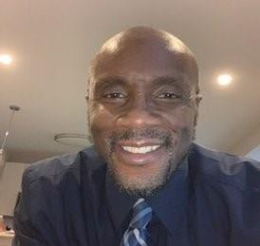
Bobby Stinnette
Accessibility Specialist
U.S. Access Board

Slide 5
Background
Section 510 of the Rehabilitation Act charges the Access Board with developing and maintaining accessibility standards for medical equipment used by health care providers for diagnostic purposes.
In 2017, the Access Board issued Medical Diagnostic Equipment (MDE) standards establishing minimum technical criteria to ensure that medical diagnostic equipment in physician's offices, clinics, emergency rooms, hospitals, and other medical settings is independently accessible to, and usable by, individuals with disabilities.

Slide 6
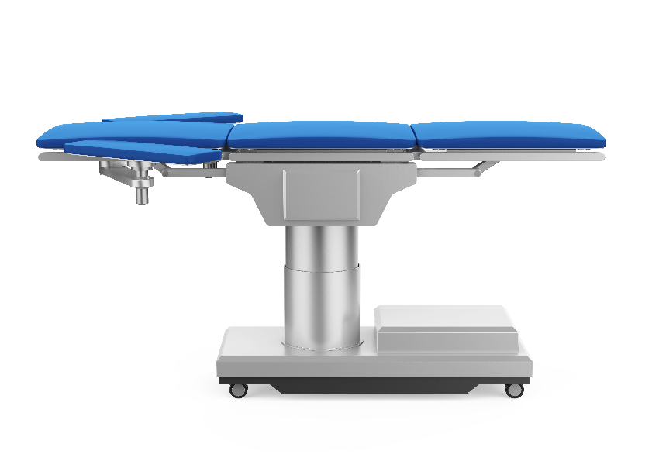
Background Continued…
Among other specifications, Medical Diagnostic Equipment Standards address:
the height and adjustability of MDE equipment that patients who use wheelchairs must transfer onto, including examination tables and chairs, procedure tables, and imaging equipment with tables.

Slide 7
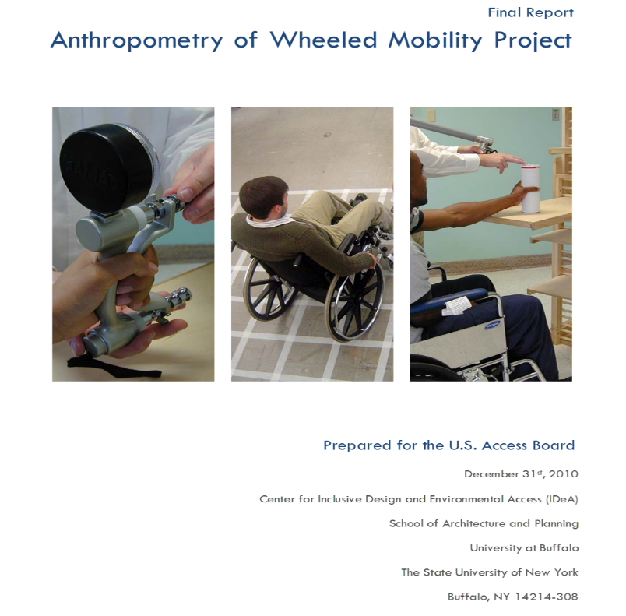
Rulemaking on Medical Diagnostic Equipment Standards
December 2010 – Final Report: The Anthropometry of Wheeled Mobility Project collected anthropometric data on 495 people who use wheeled mobility devices in the United States conducted by the University of Buffalo Center for Inclusive Design and Environmental Access (IDeA Center).
Researchers measured wheelchair seat height, occupied length, turning radii, reach ranges, and other dimensions.
Finding: occupied seat heights for people who use wheeled mobility devices vary considerably.

Slide 8
Notice of Proposed Rulemaking for MDE Standards
February 2012: the Access Board sought public comment on whether the height of transfer surfaces should be adjustable within a range of 17 inches minimum and 25 inches maximum.
July 2012: the Access Board organized an advisory committee representing stakeholders to provide recommendations on how the MDE Standards should be finalized based on the public comments received.
Most commenters supported a requirement for adjustability and a high transfer surface height of 25 inches but a consensus was not reached on what the low transfer height should be.
Notes:
Title of the slide will be Notice of Proposed Rulemaking for the medical diagnostical equipment standards

Slide 9
Medical Diagnostic Equipment Final Rule
January 2017 – Access Board issued a final rule:
Transfer surfaces to be adjustable 17–19 to 25 inches
Four unspecified heights between the high and low
Approach taken due to insufficient information on low transfer height
Five Year Sunset provision extended to January 2025

Slide 10
Further Research
In 2021, the Access Board commissioned a secondary analysis of the Anthropometry of Wheeled Mobility database.
Analysis was undertaken because some segments of the population test sample were over- or under-represented.
Researchers statistically resampled the data.
Notes:
on occupied seat heights for manual and powered wheelchair users to create virtual samples that were proportionally representative of the total population of wheelchair users in the United States.

Slide 11
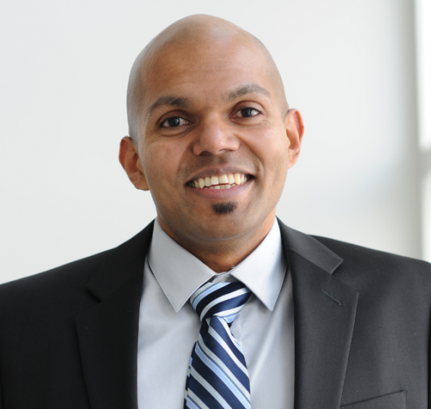
Clive D’Souza, Ph.D.
University of Pittsburgh
Dept. of Rehabilitation Science and Technology

Slide 12
Goals of the AWM Project
Develop reliable and accurate methods for measuring the anthropometry of wheeled mobility users.
Collect anthropometric data on a large sample of contemporary wheeled mobility users, especially users of powerchairs and scooters.
Develop a database that can serve as a foundation for a long-range research program.
Develop design tools and recommendations for use in technical assistance and design.

Slide 13
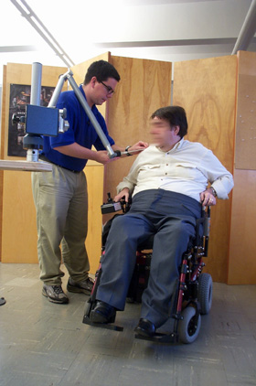
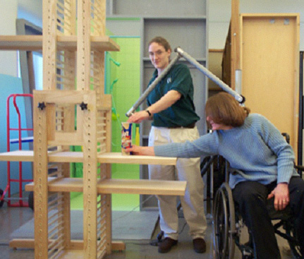
Data collection methods
Structural measurements
Reach measurements

Slide 14
Study Sample
500 wheeled mobility device users
  264 (53%) men, 236 (47%) women
  277 (55%) manual chair, 189 (38%) power chair, 34 (7%) scooter users
Used a wheeled mobility device as the primary means of mobility
Diverse medical conditions: spinal cord injuries, cerebral palsy, multiple sclerosis, stroke, amputations, etc.
Study locations: Greater Buffalo Area-NY, Ithaca-NY, Pittsburgh-PA

Slide 15
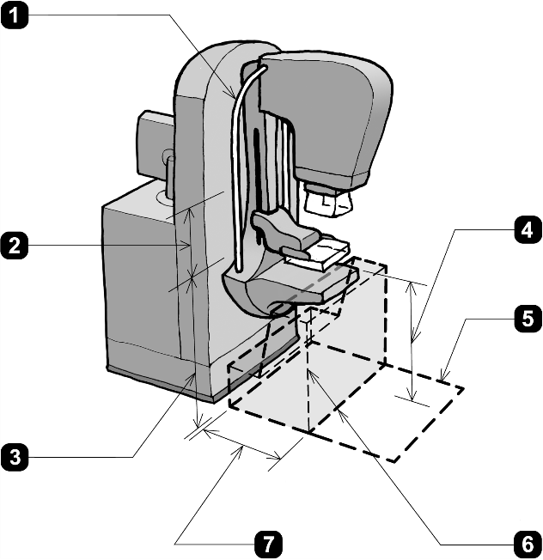
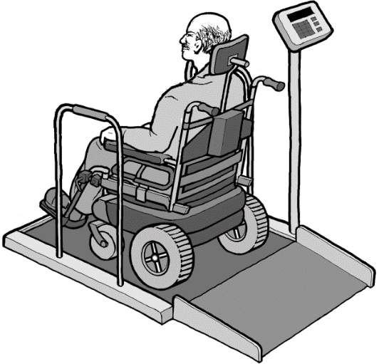
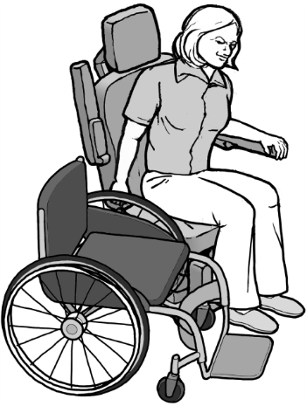
Standards for Accessible Medical Diagnostic Equipment
Knee-toe clearances and chest height for mammography machines
Device dimensions for sizing weight scales
Occupied seat height ranges for side transfers

Slide 16
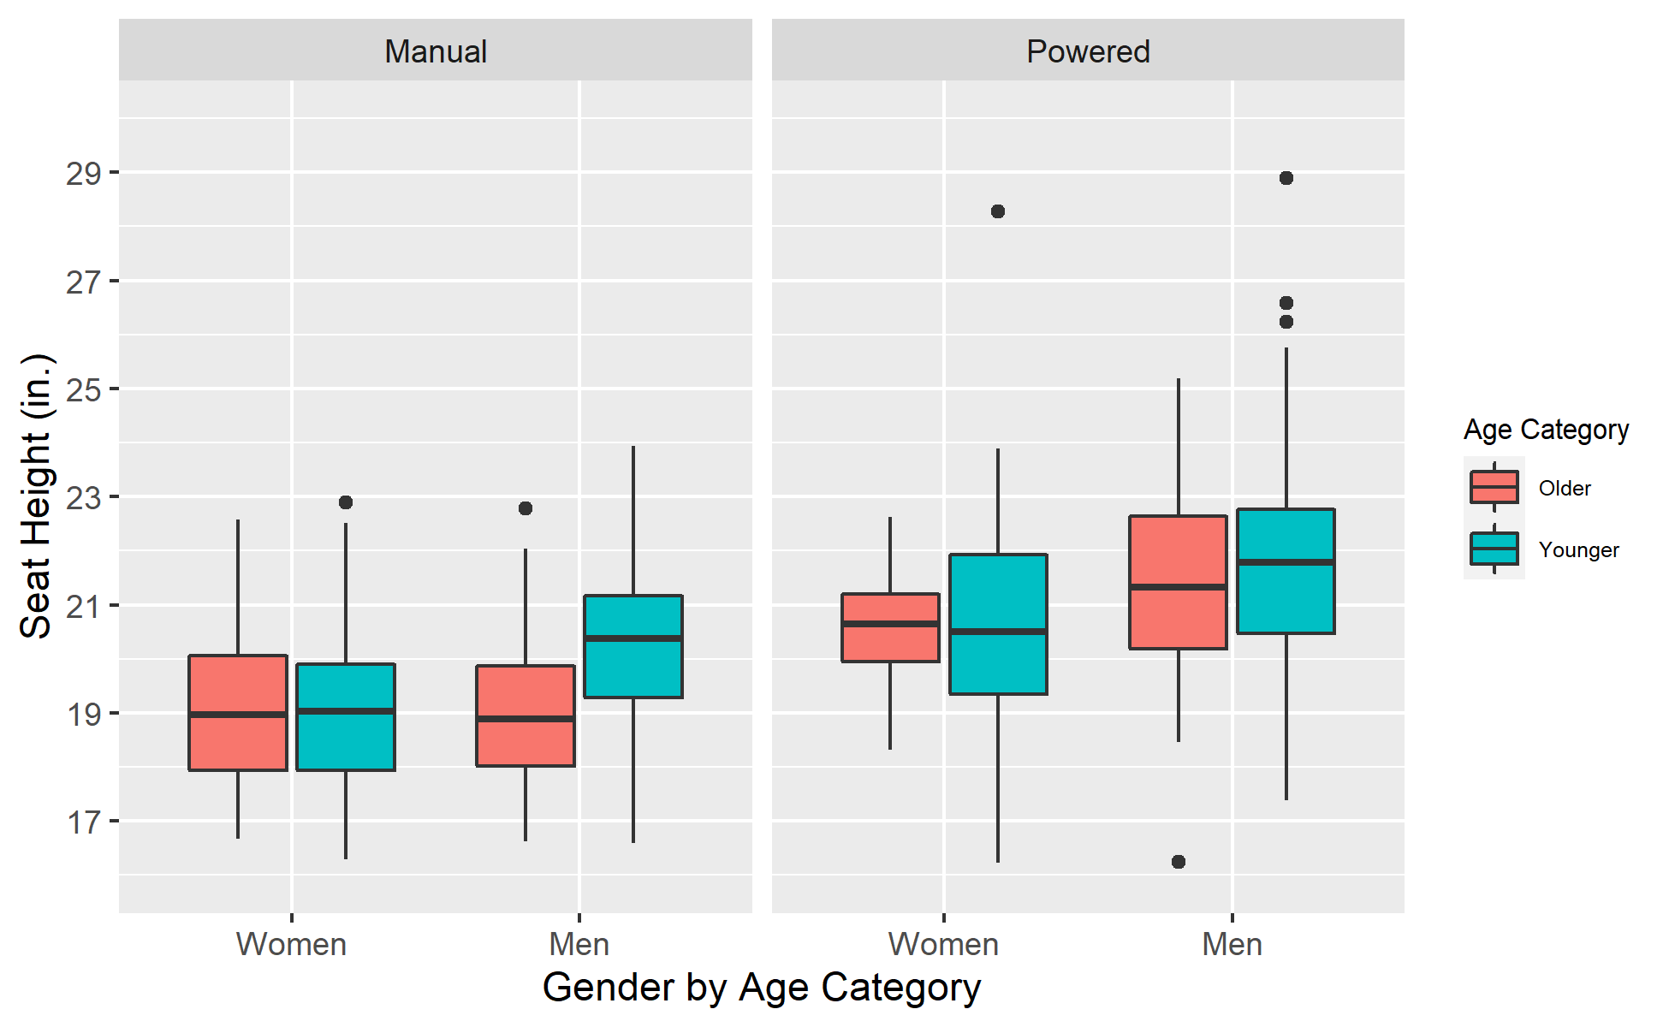
Occupied Seat Heights
Distribution of occupied seat heights in the original IDeA Center AWM dataset
Diverse seat heights between and within manual and powered wheelchairs (n = 466)

Slide 17
Demographic Proportions:
Study Sample vs. National Estimates
Note: These proportions intentionally exclude scooter users.
 |  | IDeA Center Study Sample (original) |  |  |  | 1994-97 NHIS-D Proportions (target)
Age | Gender | Manual | Powered | Total |  | Manual | Powered | Total
18-64 | Men | 23.0 | 16.7 | 39.7 |  | 17.6 | 2.8 | 20.5
 | Women | 13.3 | 12.4 | 25.8 |  | 18.6 | 3.0 | 21.6
65+ | Men | 8.6 | 4.7 | 13.3 |  | 18.8 | 1.0 | 19.8
 | Women | 14.6 | 6.7 | 21.2 |  | 36.1 | 2.0 | 38.1
Total % |  | 59.4 | 40.6 | 100.0 |  | 91.1 | 8.8 | 100.0
A deliberate oversampling of powered wheelchair users in the IDeA Center study

Slide 18
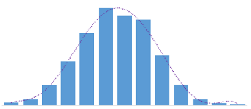
Overview of the Resampling Methodology
8 sub-groups
Manual, Men, Younger
N₁ = 500
Compute statistics, percentiles
Manual, Men, Older
Manual, Women, Younger
N₂ = 500
Compute statistics, percentiles
Manual, Women, Older
Perform random selections with replacement by subgroup as per NHIS-D proportions
Compute averages of the statistics and percentiles over all 100 samples
Power, Men, Younger
N₃ = 500
Compute statistics, percentiles
Original IDeA Center sample, N = 466
Power, Men, Older
Power, Women, Younger
Power, Women, Older
N₁₀₀ = 500
Compute statistics, percentiles

Slide 19
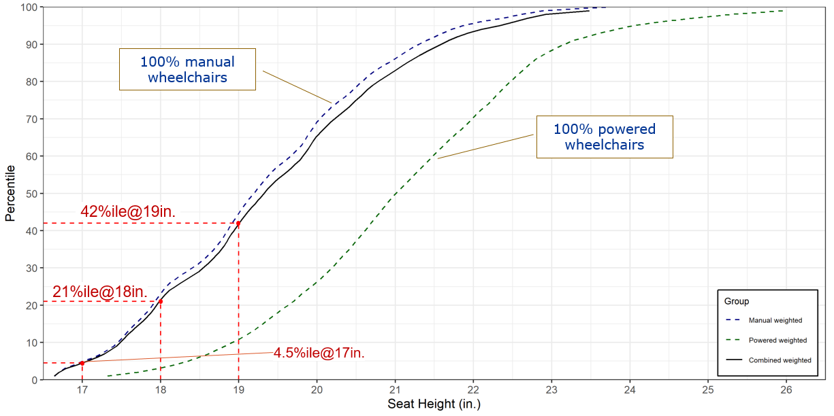
Percentile Plot: Proportionally Weighted Seat Heights

Slide 20
Exploring Changes in Demographic Proportions
What if the percentage of powered wheelchair use has increased by 10% or 20%?
 |  | 1994-97 NHIS-D Proportions |  |  |  | +10% Powered Wheelchairs |  |  |  | +20% Powered Wheelchairs
Age | Gender | Manual | Powered | Total |  | Manual | Powered | Total |  | Manual | Powered | Total
18-64 | Men | 17.6 | 2.8 | 20.5 |  | 15.1 | 5.3 | 20.5 |  | 12.6 | 7.8 | 20.5
 | Women | 18.6 | 3.0 | 21.6 |  | 16.1 | 5.5 | 21.6 |  | 13.6 | 8.0 | 21.6
65+ | Men | 18.8 | 1.0 | 19.8 |  | 16.3 | 3.5 | 19.8 |  | 13.8 | 6.0 | 19.8
 | Women | 36.1 | 2.0 | 38.1 |  | 33.6 | 4.5 | 38.1 |  | 31.1 | 7.0 | 38.1
Total % |  | 91.1 | 8.8 | 100.0 |  | 81.1 | 18.8 | 100.0 |  | 71.1 | 28.8 | 100.0
+10%
+10%

Slide 21
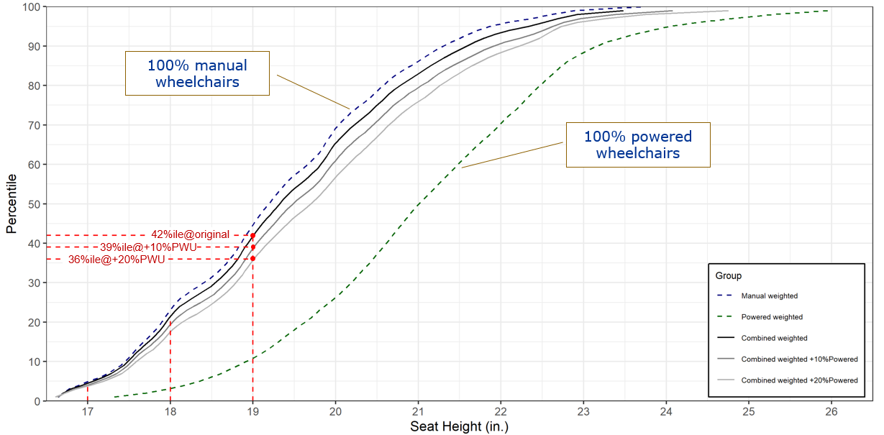
Percentile Plot: Increase in Powered Wheelchair %

Slide 22
Conclusion
Statistical resampling was used to generate proportionally representative samples.
Estimated the proportion of wheelchair users with seat height ≤ 17”, 18” and 19”
  If the lower height limit of MDE transfer surfaces were set to 17”, 18”, or 19”, then the proportion of wheelchair users excluded is estimated to be no more than 4.5%, 21%, and 42%, respectively.
  Due to the small proportion of powered wheelchairs in the 1994-97 NHIS-D survey, percentiles for the combined proportional sample were similar to percentiles for manual wheelchairs.
Statistical resampling allowed for estimating the potential influence of increasing powered wheelchair proportions
  at 19”, a 10% increase in powered wheelchairs decreased the percent excluded from 42% to 39%
  at 17”, a 10% increase in powered wheelchairs decreased the percent excluded from 4.5% to 4%
Setting design specifications near the lower end of the distribution (e.g., 17” or 17.5”) would be less affected (more robust) to future changes in population demographics.

Slide 23



References
Analysis of Low Wheelchair Seat Heights and Transfer Surfaces for Medical Diagnostic Equipment: Final Report
  https://www.access-board.gov/research/human/wheelchair-seat-height/
Anthropometry of Wheeled Mobility Project: Final Report prepared for the U.S. Access Board
  http://idea.ap.buffalo.edu/projects/anthropometry/

Slide 24
Thank you!
Clive D’Souza, PhD
email: crd85@pitt.edu
o: 412-383-2758, m: 716-353-5837

Slide 25
Questions about the Study
You may type and submit questions in the Q&A Area

Slide 26
Request for Information
The Access Board is particularly interested in:
The low height of adjustable MDE products currently on the market.
Changes or innovations in the design and engineering of MDE that may have occurred since the Board issued standards in 2017.
Updated information on the incremental costs for the design or redesign and manufacture of MDE that can provide a low transfer height of 17 inches.

Slide 27

Public Comments
Request to share information, ideas, or comments using Zoom’s Q & A feature:
  Name (and organization)
  Brief description of content
Host will enter you into queue
Moderator will announce when you should unmute (*6 by phone)
Moderator will also announce next in que
Presenters may respond to some comments
Alternative: events@access-board.gov
ASL – note in request to comment
Please limit comments to < 3 min.

Slide 28

Written Comments
Comments may be submitted until May 27, 2022.
Submit written comments via email to:
mde@access-board.gov

Slide 29
Further Information
U.S. Access Board
mde@access-board.gov
www.access-board.gov
(800) 872-2253 (voice)
(800) 993-2822 (TTY)

Slide 30
Thank you for joining us today.
This concludes our event. This event has been recorded, and the recording will be available on the Access Board’s homepage and its YouTube Channel soon.

Slide 31

Next presenter…

